Slide 1
Meeting 06/08/2020
Naudé Conradie
19673418

Slide 2
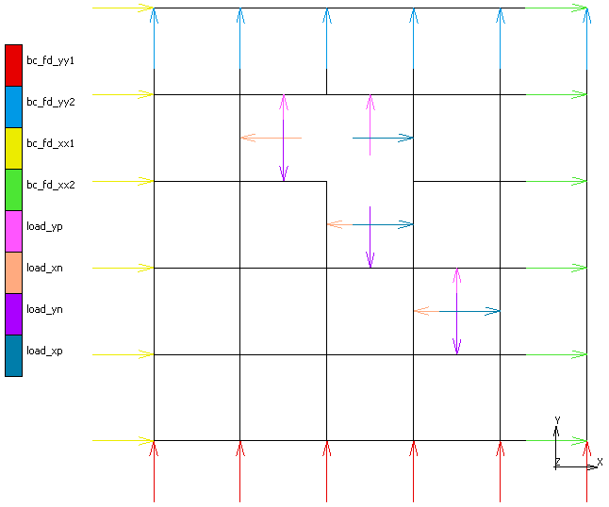

Internal Pressure

Slide 3
Code
Unit selection
pandas dataframe
Sort according to selection criteria
Select n best units
Size determination
Best size for units?

Slide 4
Issues
Network issues
Encounter many network timeouts while VPN connected
Occasionally MarcMentat won’t open
Slow network may be reason for simulation runtime
SSD did not massively improve runtime (18-23s)
Runtime massively increases when network is slow (60-80s)
Alternatively, incorrect/inefficient setup

Slide 5
Admin
Quarterly Report
Thank you for the feedback
Next one/changes?

